Slide 1

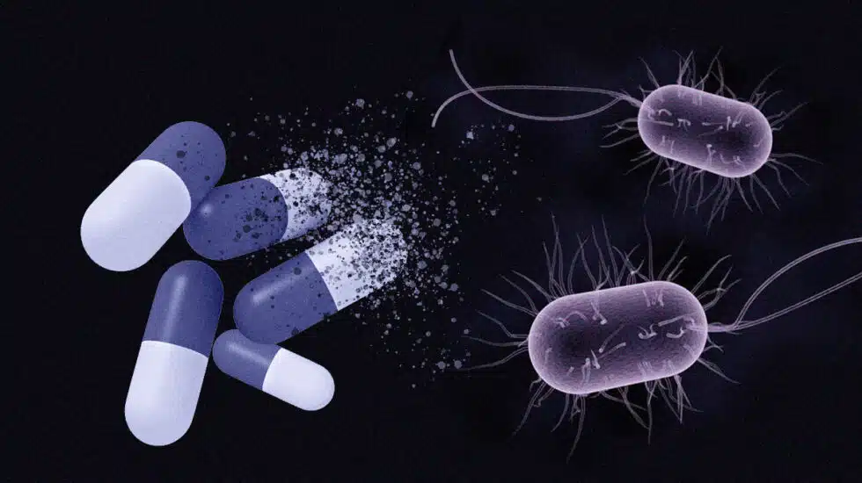
SILENT PANDEMIC
Final project by Katherine chulvi

Slide 2

INTRODUCTION
SILENT PANDEMIC TRAILER

Slide 3
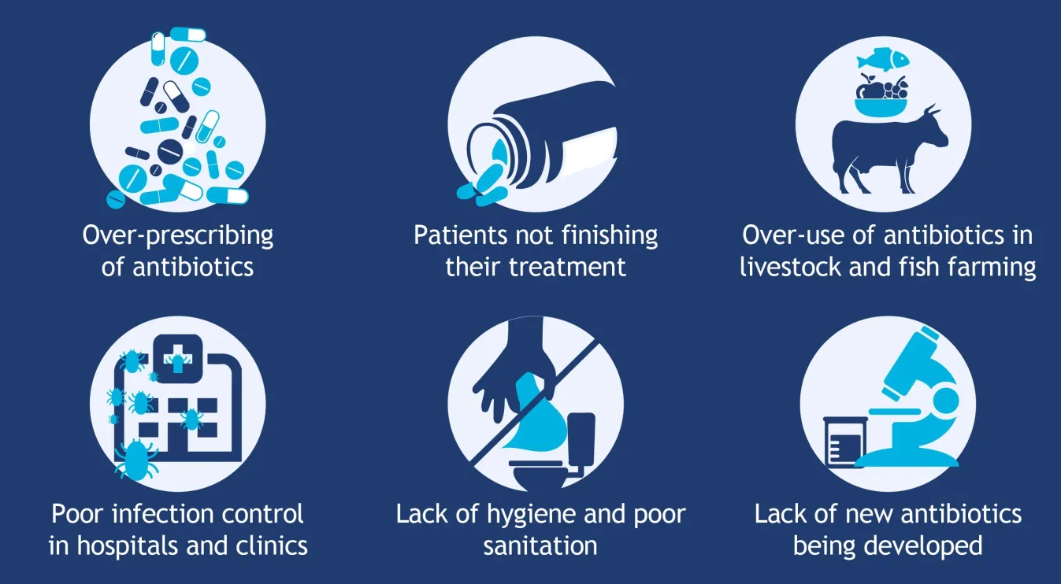
INTRODUCTION
CAUSES OF ANTIMICROBIAL RESISTANCE (AMR)
Notes:
In resume, antibiotic (or antimicrobial) resistance happens when bacteria change and become resistant to the antibiotics used to treat the infections they cause.
You can imagine how dangerous it can be if the medications are not making any effect.
Among the various causes that can contribute to the spread of this resistance, in this study, we'll investigate our diet. In concrete the meat consumption.

Slide 4
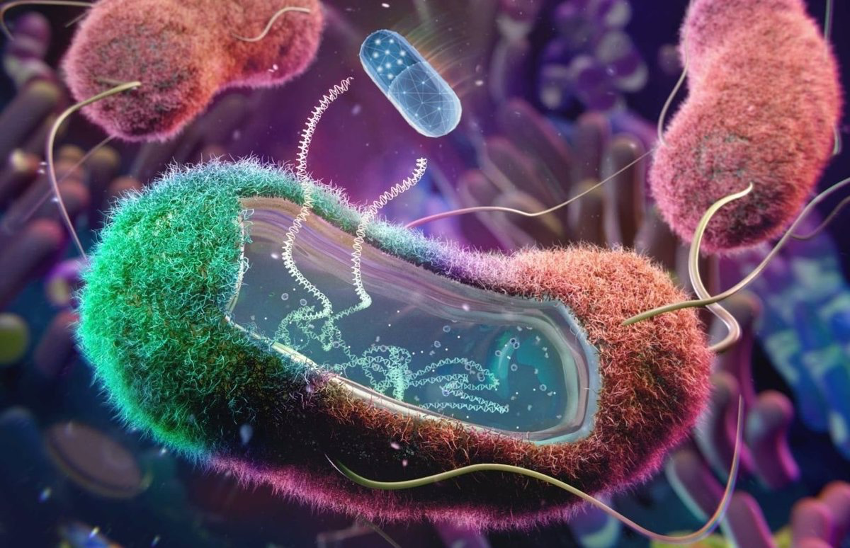
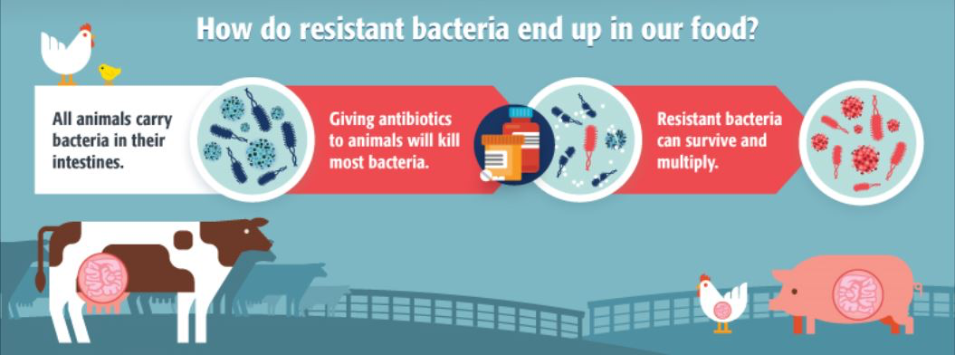
WHY MEAT?
Animals develop antibiotic resistance.
Resistant bacteria on crops.
Consumed, persist in humans.
Also on meat, spreads.
Notes:
Animals receive antibiotics and develop resistant bacteria in their systems.
Fertilizer or water containing animal feces and drug-resistant bacteria are used on food crops.
Drug-resistant bacteria in animal feces can persist on crops and be consumed. These bacteria can also persist in the human digestive system.
These resilient bacteria can also be present in meat. When not handled or cooked properly, the bacteria can spread to humans.

Slide 5
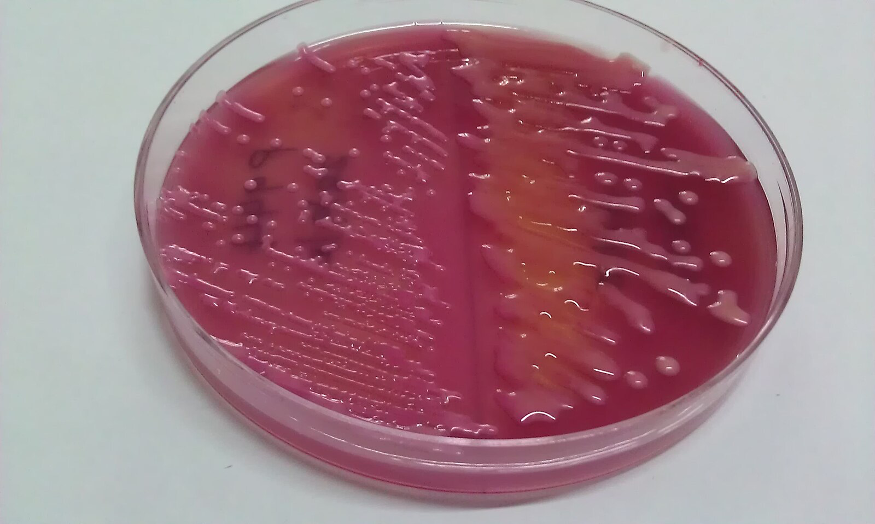

GETTING OUR DATA
AMR vs MEAT CONSUMPTION
PATHOGENS
E. Coli
K. pneumoniae
ANTIBIOTICS
- Aminoglycosides
- Carbapenems
- Fluoroquinolones
- Cephalosporins
AMR(%) in Europe by
Gender
Age
MEAT CONSUMPTION
in Europe over 2002, 2009 and 2020
Combination with higest AMR(%) of Pathogen|Antibiotic|Group population
Notes:
For this study, we chose two types of pathogens, one very common and usual related with light infections, E. coli, and another that causes severe damage in our systems and is one of those responsible for causing sepsis (which is death due to infection), called K. pneumoniae.

Slide 6
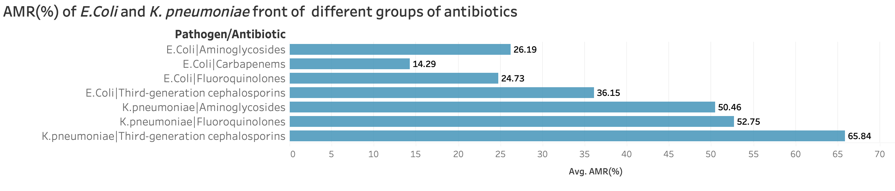
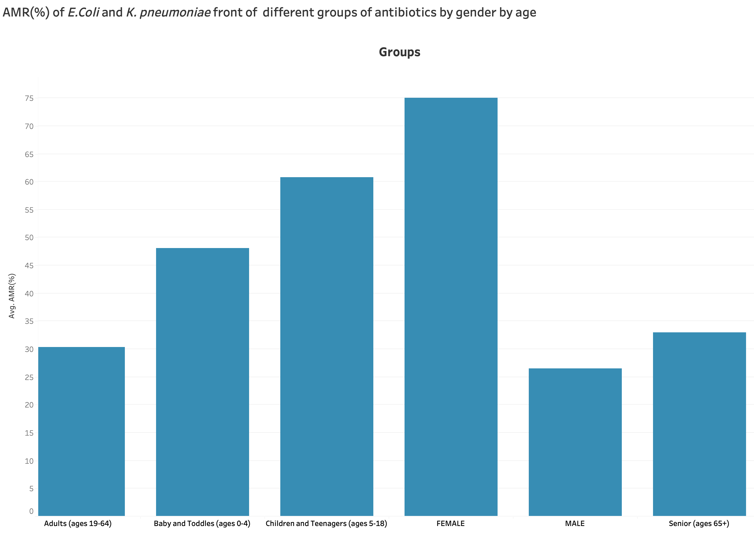
RESULTS AND VISUALIZATIONS
Notes:
The combination of pathogen\antibiotic which show more resistance is the Kpneumoniae front of the Cephalosporins, so will look at it deeper later.
The group more affected by the resistance are the females followed by children babies. In the last position are the males that are less affected for the combination which show more resistance.

Slide 7
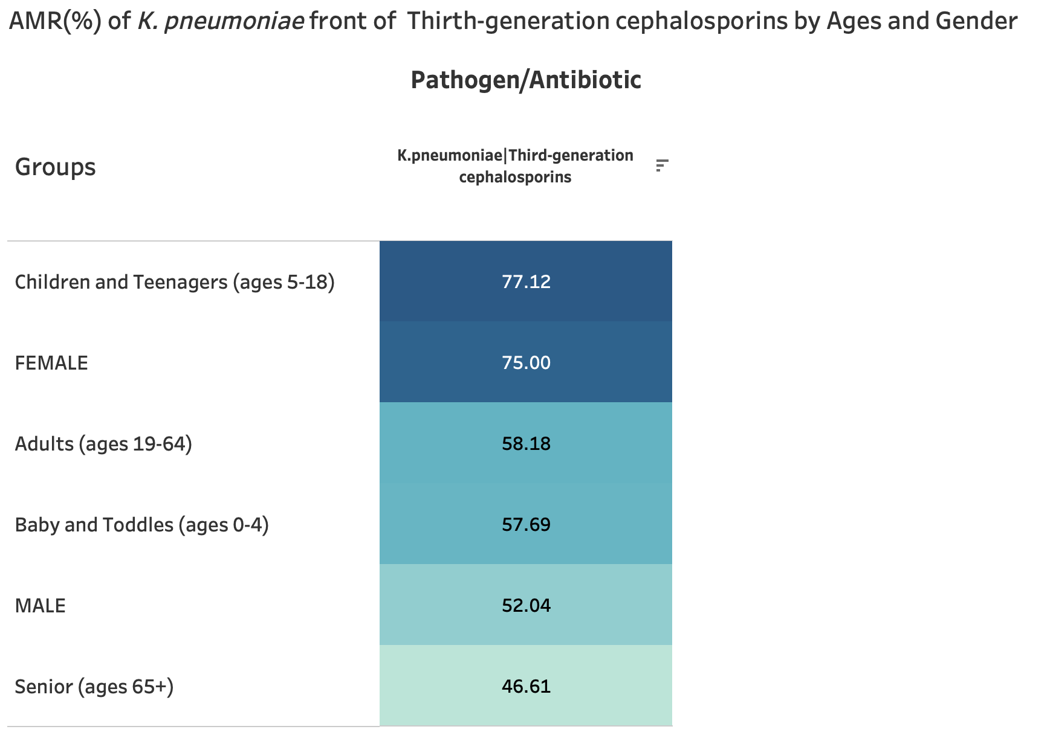
RESULTS AND VISUALIZATIONS
Notes:
Here we go deeper looking at K.pneumoniae against cephalosporins as a compleat example.

Slide 8
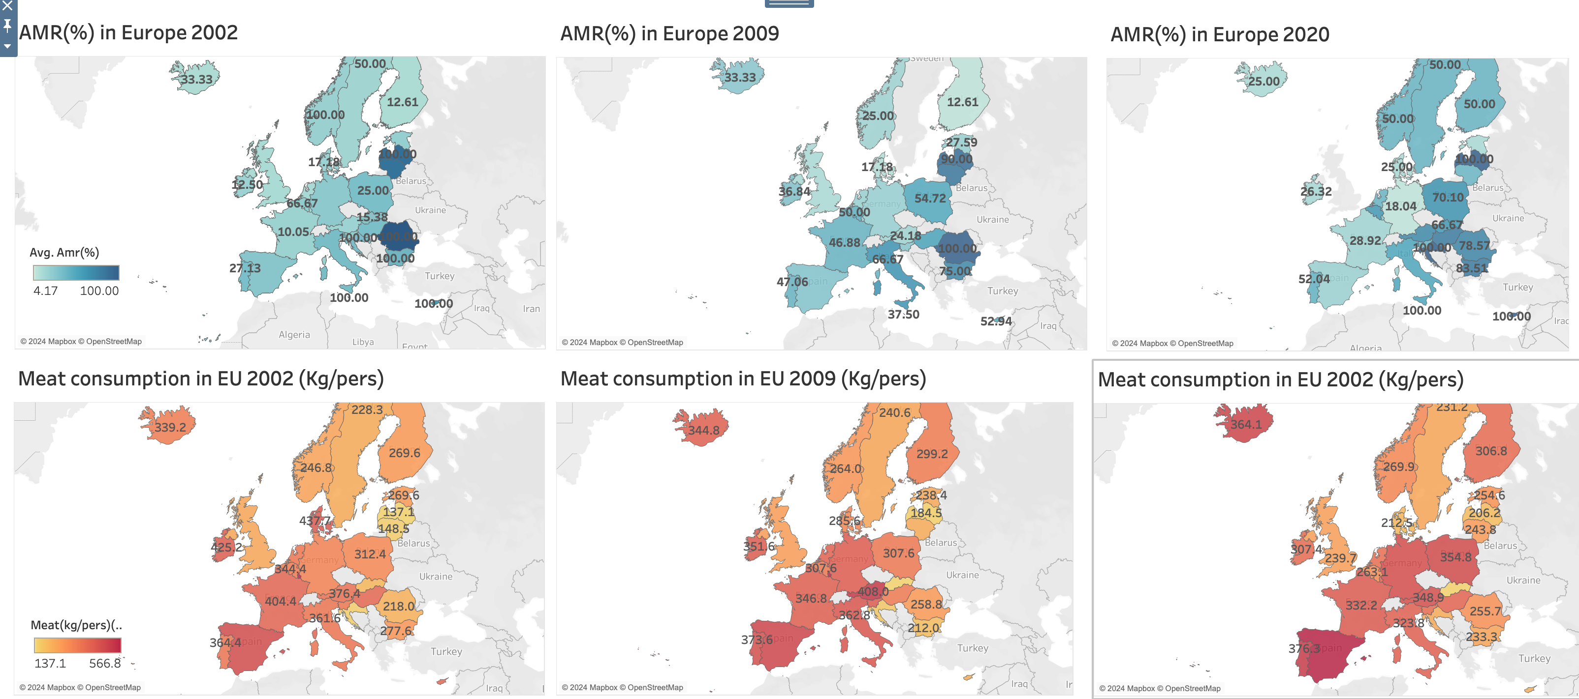
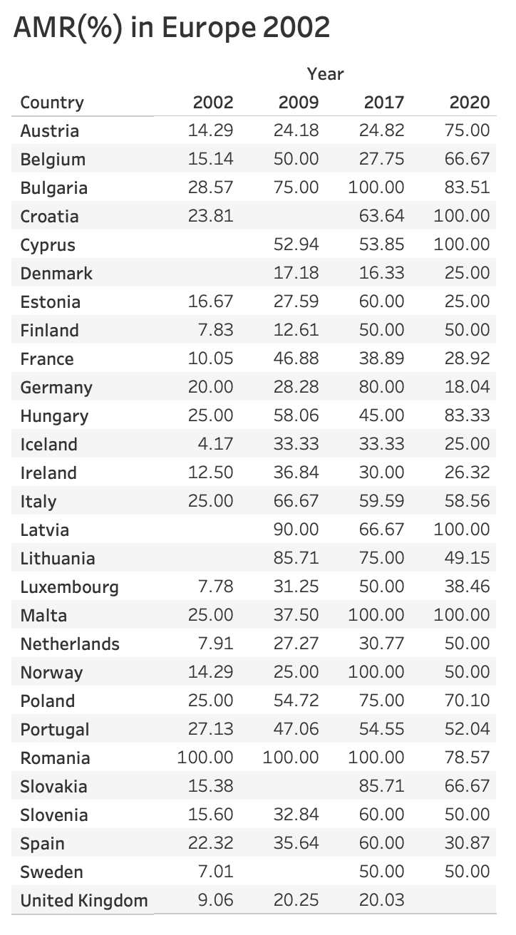
RESULTS AND VISUALIZATIONS

Slide 9
RESULTS AND VISUALIZATIONS
AMR(%) in Europe
Notes:
All have a tendency to increase except for the following countries

Slide 10
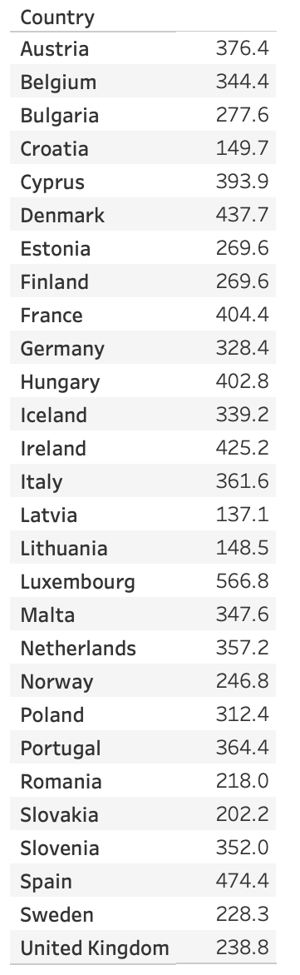
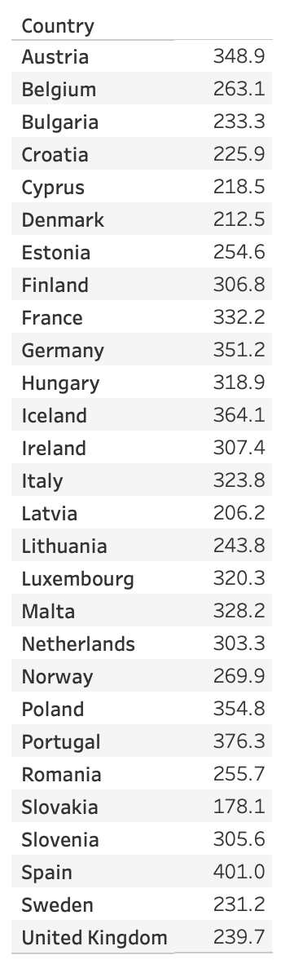
RESULTS AND VISUALIZATIONS
MEAT consumptionin Europe
Notes:
On the other hand for the meat consumption the general tendency over the years is to decrease except for…

Slide 11
CONCLUSIONS
Is not possible to prove the relationship between AMT(%) increase and meat consumption for this data.
It’s our responsibility make efforsts to reduce the spread of this dangerous resistance.

Slide 12
THANK YOU ALL FOR
YOUR ATTENTION AND SUPPORT
DURING THIS BOOTCAMP

